Slide 1
Ulwazi mayelana nezindlela zokuvikela isandulela ngculaza ongakhetha kuzo

Slide 2
Izindlela zokuvikela isandulela ngculaza ongakhetha kuzo
Ziningi izinto ongazenza ukunciphisa incuphe yokutheleleka ngesandulela ngculaza wena no phathina wakho.
Abeluleki bafuna ukukusiza ukuze uqonde zonke lezizindlela ezilandelayo zokuvikela isandulela ngculaza yikhona uzozikhethela ezokusebenzela kahle wena.

Slide 3
Ucwaningo likhombisile ukuthi iringi yestho sangasese yabesifazane ingawanciphisa amathuba okuthelele ngesandulela ngculaza. Izinga lokuvikeleka libaphezulu uma usebenzisa iringi zikhathi zonke.
Senenzisa iringi yesitho sangasese yabesifazane zikhathi zonke

Slide 4
Sebenzisa amakhondomu nasosonke Isikhathi
Sebenzisa ikhondomu ngendlela eyiyo ngasosonke isikhathi uma uya ocansini, lwesitho sangasese, lwesezinqeni noma umlomo.
Notes:
Bheka ingemuva lalelipheshana ngolwazi olwengeziwe ngamakhondomu.

Slide 5
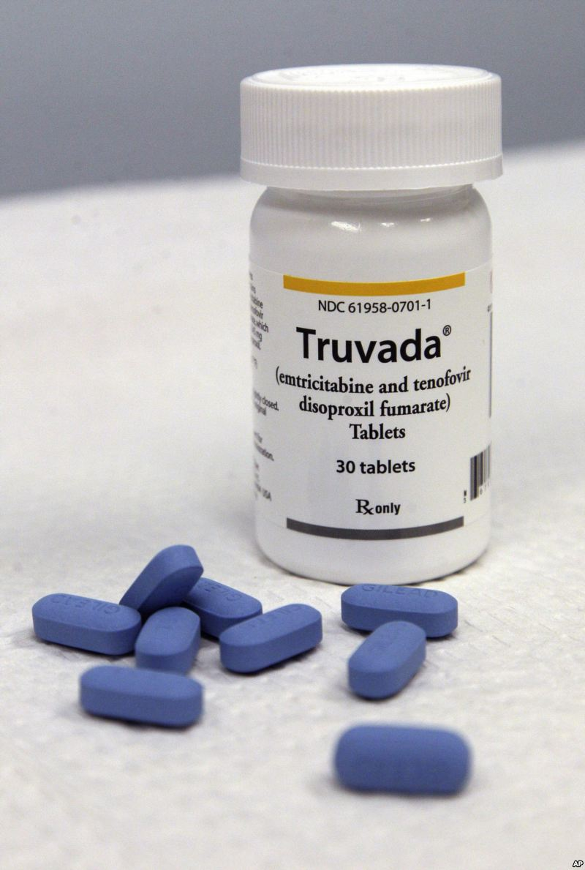
Sebenzisa iPrEP (ukusebenzisa ama – ARV ukuvimbele ukutheleleka ngesandulela ngculaza) ethathwa ngomlomo (isibonelo. Truvada)
IPrEP ethathwa ngomlomo iyindlela yokuvikela isandulela ngculaza engakhethwa abantu abangakabi naso isandulela ngculaza kodwa abasengcupheni enkulu yokutheleleka ngesandulela ngculaza.
I-PrEP ethathwa ngomlomo ibandakanya ukuphuza imithi ethile yama ARVs nsuku zonke.
I – PrEP ethathwa ngomlomo kungenzeka iyatholakala noma ayitholakali emphakathini ohlala kuwo.
Notes:
Umalokhu kuzwakala njengenye indlela ongayisebenzisa, xoxisana nomsebenzi wasocwaningweni uzwe ukuthi uzwe ukuthi ungayithola kuphi eduze nendawo ohlala kuyo.

Slide 6
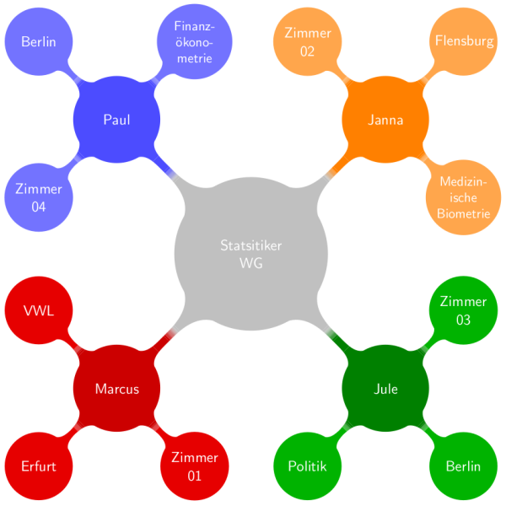
Nciphisa isibalo sophathini oyanabo ocansini
Notes:
Inani lophathina oya nabo ocansini, kwenyusa amathuba okuhlangana nomuntu osethelelekile ngesandulela ngculaza. Uma uphathina wakho enophathina abaningi aya noabo ocansini, mgqugquzele ukunciphisa isibalo naye. Lokhu kungehlisa incuphe yokutheleleka ngesandulela ngculaza kinina nonke.

Slide 7
Zibandakanye nemokhuba enencuphe encane yezocansi
Ucansi lwasemlonyeni lunengcuphe encane kunocansi lesitho sangasese noma lwasezinqeni. Iningi Labantu licabanga ukuthi ucansi lwasezinqeni lunobungozi obuncane, kodwa empeleni yilona olunobungozi kunazo zonke uma kuziwa ekuthelelekeni ngesandulela ngculaza.

Slide 8
Uma unesifo esithatelana ngokocansi (STI) thola ukwelashwa
Ukuba nesifo esithathelana ngokocansi kungandisa ingcuphe yokutheleleka ngesandulela ngculaza noma ukulidlulisela kwabanye. Gcizelela ukuthi ophathina bakho bahlolwe futhi belashwe.

Slide 9
Qguqguzela uphathina wakho ahlolelwe isandulela ngculaza
Khuluma nophathina ngokuhlolela isandulela ngculaza nangohlolela isandulela ngculaza ngaphambi kokuya ocansi.
Ukwazi ukuthi uphathina wakho unesandulela ngculaza kungakusiza ukwenza isinqumo ngezinhlela zokuvikela ezingasebenza kancono.

Slide 10
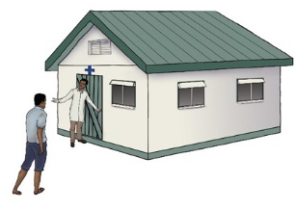
Qguqguzela uphathina wakho ukuthi asoke
Abesilisa abasokiwe banamathuba ayisigamu kunabesilisa abangasokiwe okutheleleka ngesandulela ngculaza.
Ukusoka kwabesilisa akumvikeli owesifazane ukuthi atheleleke ngesandulela ngculaza.

Slide 11
Uma uphathina wakho enesandulela ngculaza ngqugquzele ukuthatha imi mgqugquzela ukuthatha imithi yesandulela ngculaza ngendlela ayalelwe ngayo
Notes:
Ukwelashwa ngemith yokudambisa isandulela ngculaza (abizwa nge- Antiretroviral therapy noma kafushane in ART) kusuza abantu abanesandulela ngculaza baphile Isikhathi eside. Ama-ART ayaliphi ngculaza, kodwa inciphisa inani lesandulela ngculaza emzimbeni. Ukuba nenani eliphansi lesandulela ngculaza emzimbeni kunciphisa incuphe yokwedlulisela isandulela ngculaza kuphathina wakho ngsikhathi nenza ucansi.

Slide 12
Nakuba zonke izindlela kungelula ukuthi zisebenzele bonke abantu besefazane, ukwanda kwezinto ozenzayo, ukwanda kokuncipha kwamathuba okutheleleka ngesandulela ngculaza.

Slide 13
Ulwazi olwengeziwe ngamakhondomu
Amakhondomu avikela ekuthelelekeni ngesandulela ngculaza ocansini lwesitho sangasese nocansi lwasezinqeni.
Iringi enedipivirine inciphisa ingcuphe yokutheleleka ngesandulela ngculaza ngocansi lwesitho sangasese.
Iringi ayakhelwanga ukuvimbela ukutheleleka ngesandulela ngculaza ngocansi lwesezinqeni futhi akufanele isetshenziswe embotsheni yokuzikhulula.

Slide 14
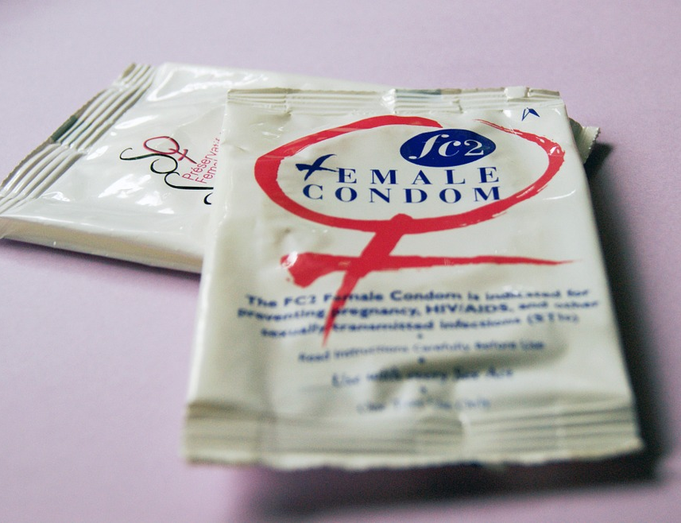
Ulwazi olwengeziwe ngamakhondomu
Amakhondomu avikela ukukhulelwa kanye nezinye izifo ezithathelana ngokocansi.
Amakhondomu elatex ayindlela engcono kunezinye ukuvikela izifo ezithathelana ngokocansi ezifana negonorrhoea, chlamydia noma itrichomonas uma esetshenziswa njalo nangendlela efanele.
Notes:
Ngaphezu kokuthi amakhondomu avikela ukutheleleka ngesandulela ngculaza, aphinde abe nezinye izinzuzo ngokwempilo.
Amanye amacouples akhetha amakhondomu njengendlela yawo yokuhlela umndeni ukuvikela ukukhulelwa okungahleliwe.
Aphinde anciphise ingcupe yezifo zezilonda zesifo sangasese ezifana neherpis yesitho sangasese, syphilis kanye nechancroid, uma Indawo esithelelekile noma okunamathuba okuthi itheleleke ivikelekile. Anganciphisa incuphe yokutheleleka ngesifo sehuman papillomavirus (HPV) nezifo ezihlobene nesifo seHPV (isibonelo: izinsumpa zesifo sangasese nomdlavuza wesibeletho).

Slide 15
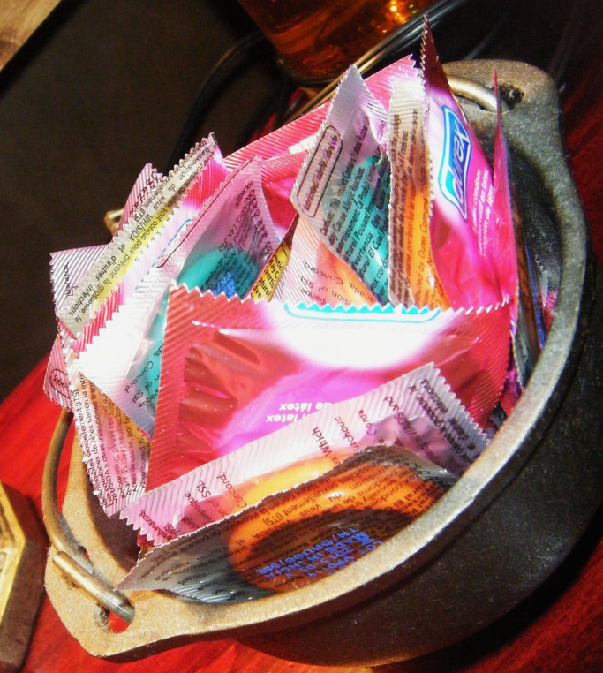
Angasetshenziswa kanjani amakhondomu ngendlela eyiyo futhi njalo
Sebenzisa ikhondomu entsha ngomzuliswani nhamunye (ngomlomo, ngesitho sangasese kanye embotsheni yokuzikhulula).

Slide 16
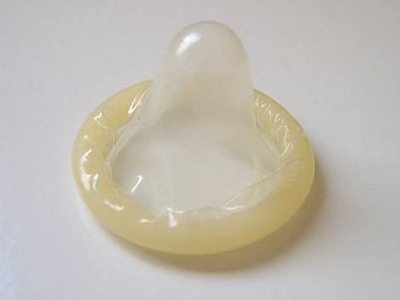
Angasetshenziswa kanjani amakhondomu ngendlela eyiyo futhi njalo
Sebenzisa amakhondomu ngokucophelela ukuvikela uyidabula ngeminwe, amazinyo noma ezinye izinto ezicijile.
Faka icondomu envakokuthi ipipi selivukile naphambi kwanoma yikuphi ukuhlangana ngesitho sangasese, umlomo noma imbobo yokuzikhulula nophathini wakho.

Slide 17
Angasetshenziswa kanjani amakhondomu ngendlela eyiyo futhi njalo
Qinisekisa ukuthi ikhondonu inamafutha okushelelisa ngesikhathi socansi lwesitho sangasese noma imbobo yokuzikhulula, kodwa sebenzisa kuphela amafutha okushelelisa anesisekelo samanzi (njeneg K-Y Jelly) namakhondomu e-latex.
Amafutha okushelelisa anesisekelo samafutha (njengoVaselina noma isgcobo somzomba) angayilimaza ikhondomu.

Slide 18
Angasetshenziswa kanjani amakhondomu ngendlela eyiyo futhi njalo
Ukugwema ikhondomu ukuthi ishibilike iphume, bamba ikhondomu iqine emsukeni wesitho sangesese ngesikhathi ukhipha, bese ukhipha isitho sangasese sowesilisa ngesikhathi sisavukile.

Slide 19
Uma unemibuzo noma udinga ulwazi olwengeziwe, sicela uvakashe Isikhungo socwaningo.

